Slide 1




Project Review III
CAREERSAGE
By
21110019 Gaurav Suresh Patil
20110081 Buddhabhushan Pramod Sapkale
20110056 Vivek Kisan Kute
Under the guidance of
Prof. A. D. Karanje

Slide 2

MOTIVATION
Our project aims to empower students with data-driven insights, guiding them toward fulfilling careers, and fostering a brighter future. We are motivated by the potential to make career choices more informed and personalized, ensuring each student's unique aspirations are realized.

Slide 3
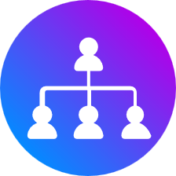


PROBLEM STATEMENT
PROBLEM
SOLUTION
Vast Career Opportunities
No proper guidance/ Biased guidance
Future threats
Unified platform for guidance
User interactive Model
Knowledge based guidance.
Current trends prediction.

Slide 4
OBJECTIVES
User friendly interactions
Skill assessment via brain games
Career guidance
Interest explorations
Current trends analysis

Slide 5






SCOPE
Enhanced Career Guidance
Improved Decision-Making
Data-Driven Insights
Continuous Improvement

Slide 6

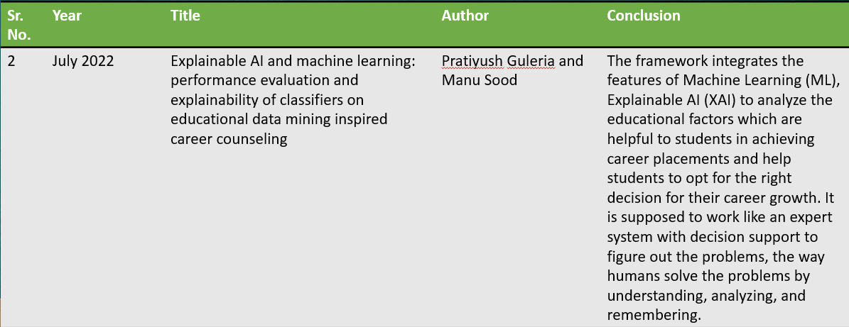
LITERATURE REVIEW

Slide 7
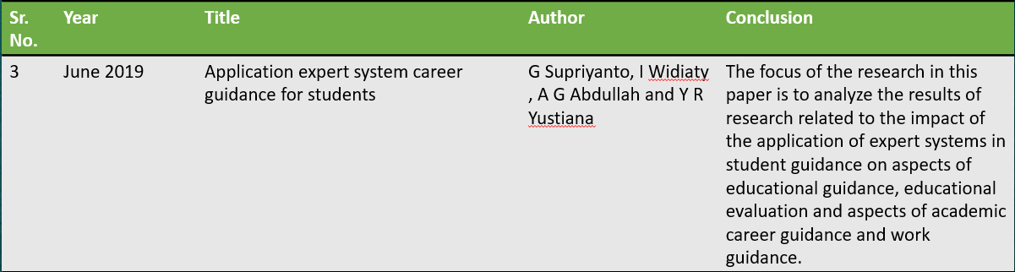
LITERATURE REVIEW

Slide 8


EXISTING SYSTEMS
LinkedIn Career Insights
Career
Builder
MyNextMove
Monster

Slide 9
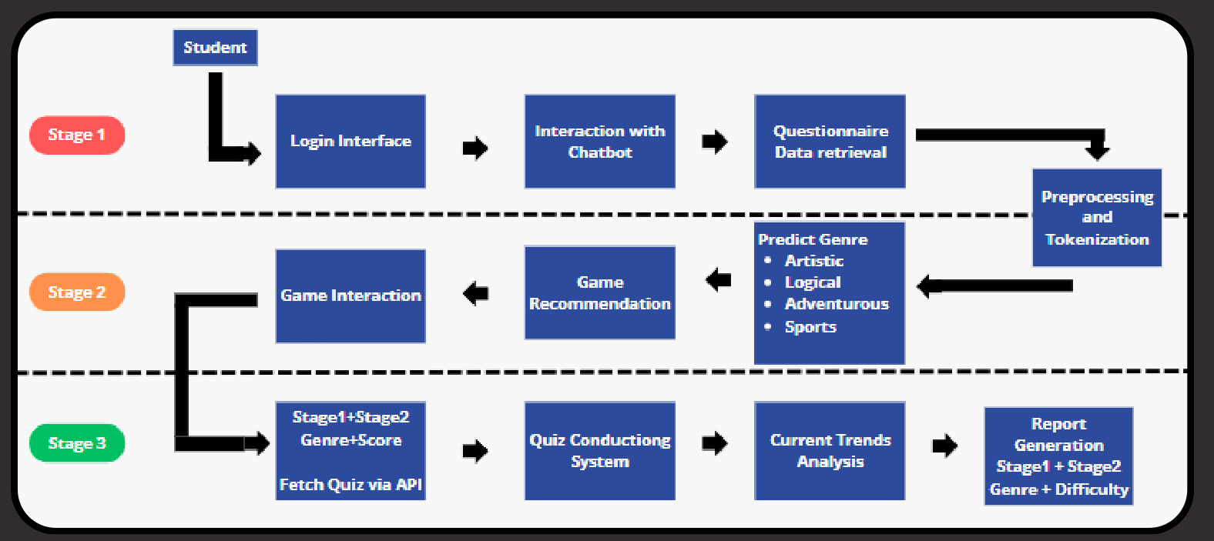
ARCHITECTURE

Slide 10
HARDWARE REQUIREMENTS
SERVER INFRASTRUCTURE
STORAGE INFRASTRUCTURE
Web Server (multicore, 16GB, SSD)
Database Storage (Cloud Storage)

Slide 11

SOFTWARE REQUIREMENTS
•PROGRAMMING LANGUAGES (Python, Django/Flask)
•DATA PROCESSING TOOLS (Numpy, Pandas)
•DEEP LEARNING FRAMEWORKS (TensorFlow, PyTorch)
•DATABASE MANAGEMENT SYSTEM (MySQL,MongoDB)
•USER INTERFACE DEVELOP (HTML/CSS/JS, React)
•VERSION CONTROL (Git)

Slide 12
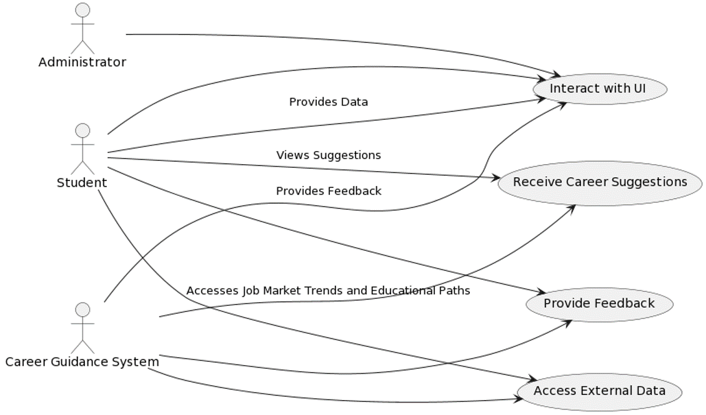
USE CASE

Slide 13
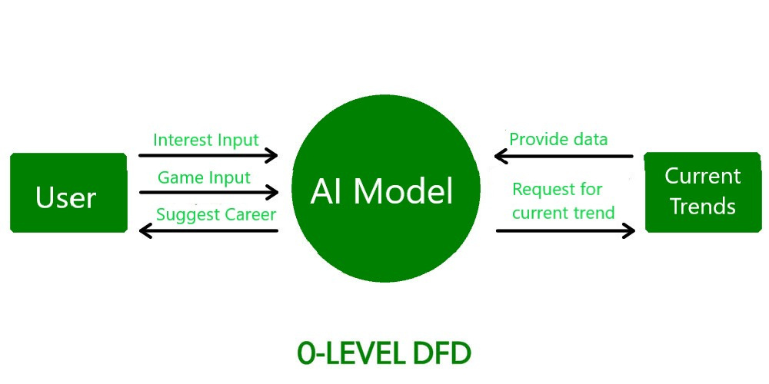

Slide 14
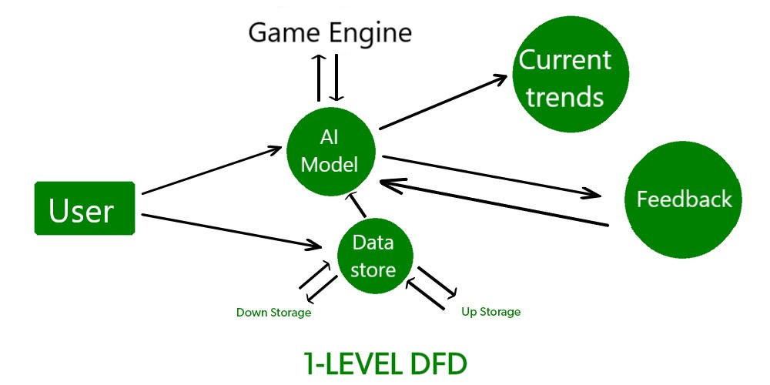

Slide 15
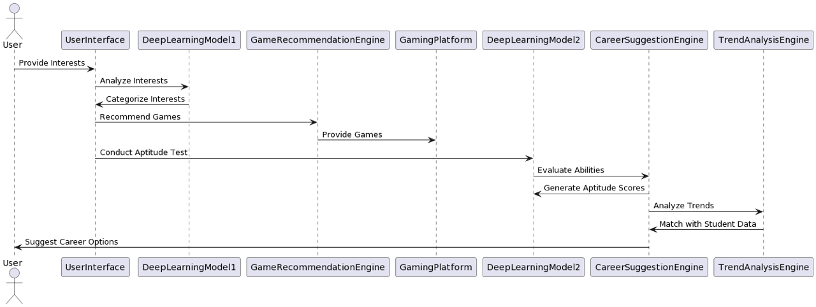
SEQUENCE DIAGRAM

Slide 16
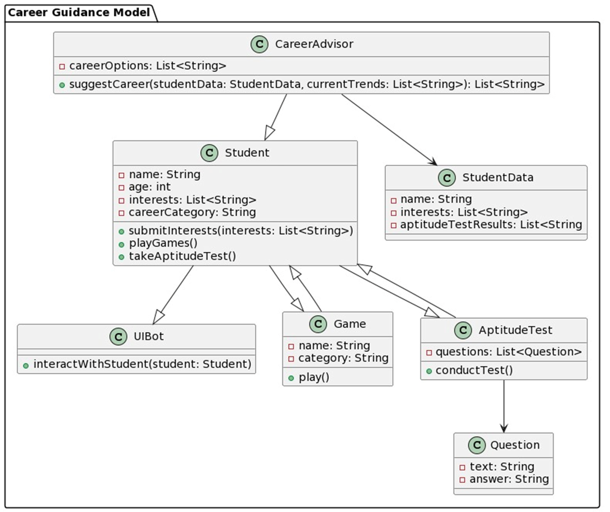
CLASS
DIAGRAM

Slide 17
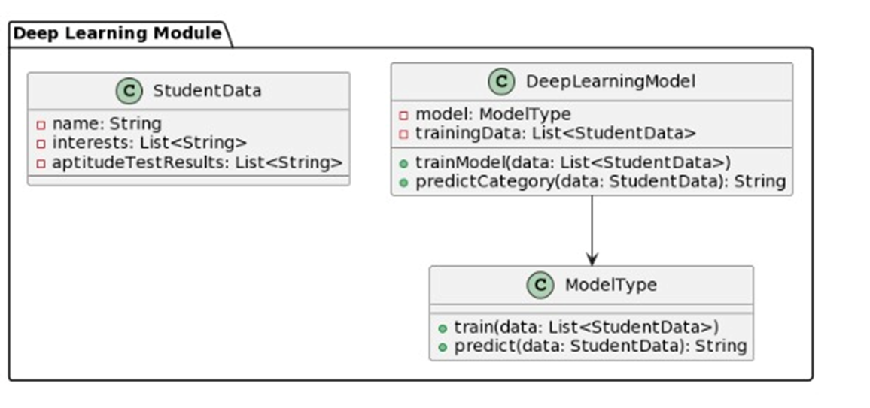
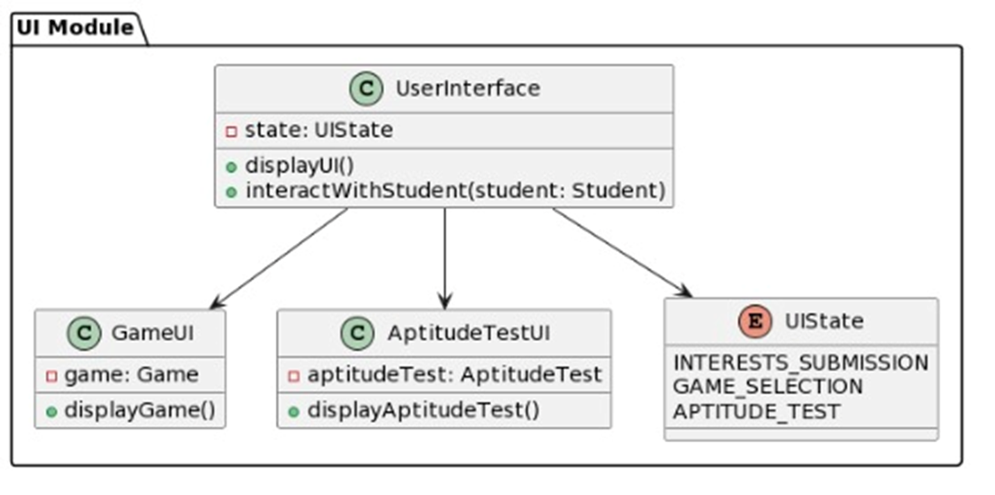
CLASS
DIAGRAMS

Slide 18
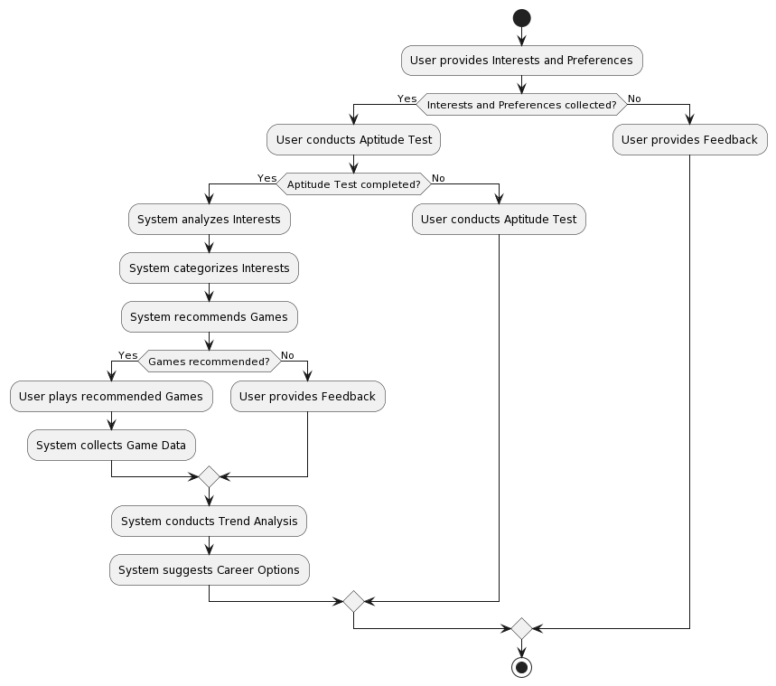
ACTIVITY
DIAGRAM

Slide 19



MODULES
User Interface Module
•Interaction with users to collect their interests.
•Presentation of career suggestions based.
Data Collection and Preprocessing Module
•Collection of user-provided data through the UI.
•Preprocessing of raw dataData validation and cleaning.
Deep Learning Module
•Interest analysis using Natural Language Processing (NLP) techniques and Game recommendation.
•Aptitude test analysis using pattern recognition and machine learning techniques.

Slide 20
MODULES
Recommendation Engine Module
Collaborative filtering algorithms for game recommendations.
External Data Integration Module
Retrieval and integration of real-time job market trends data
User Feedback and Adaption Module
•User feedback collection through the UI.
•Analysis of feedback to identify areas of improvement.

Slide 21
CONCLUSION
The career guidance project, with its user-centric approach and integration of advanced technologies, empowers students with informed career choices while prioritizing data security and adaptability for a brighter future. Its holistic design ensures personalized guidance, continuous improvement, and accessibility to diverse career opportunities.

Slide 22
REFERENCES
https://link.springer.com/article/10.1007/s10639-022-11221-2 https://www.researchgate.net/profile/Huy_Truong/publication/359422304_Development_of_an_AI_Chatbot_to_Support_Admissions_and_Career_Guidance_for_Universities/links/623b37293818892e0a6bf0b1/Development-of-an-AI-Chatbot-to-Support-Admissions-and-Career-Guidance-for-Universities.pdf?_sg%5B0%5D=started_experiment_milestone&origin=journalDetail https://iopscience.iop.org/article/10.1088/1742-6596/1402/6/066031/pdf
Artificial Intelligence and Machine Learning by Vinod Chandra S. S and Anand Hareendran S
Artificial Intelligence – A Modern Approach by StJohn D. Kelleher, Brian Mac Namee, Aoife D’Arcyuart Russell & Peter Norvig
Make Your Own Neural Network By Tariq Rashid
The Elements of Statistical Learning: Data Mining, Inference and Prediction by Trevor Hastie, Robert Tibshirani, Jerome Friedman
Pattern Recognition and Machine Learning by Christopher Bishop

